Slide 1
Welcome to our presentation
Name:Nazmia Tamanna Mouri
Id:011152025
Name:Esrat Jahan Kanon
Id:011131040

Slide 2

Topic: Fun facts about tajmahal

Slide 3
Steps of progress
Drawing
texturing
Adding text
Camera setup
Transformations

Slide 4
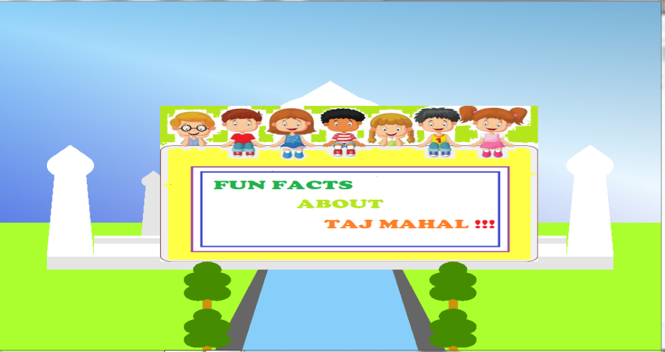
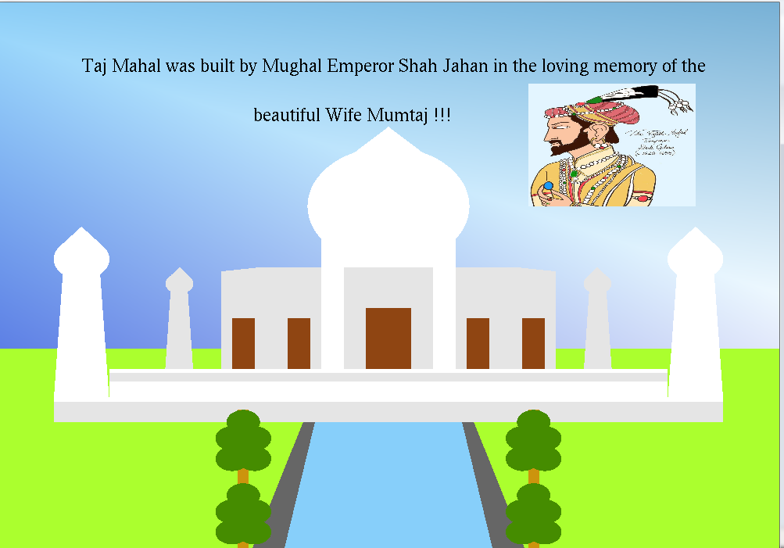
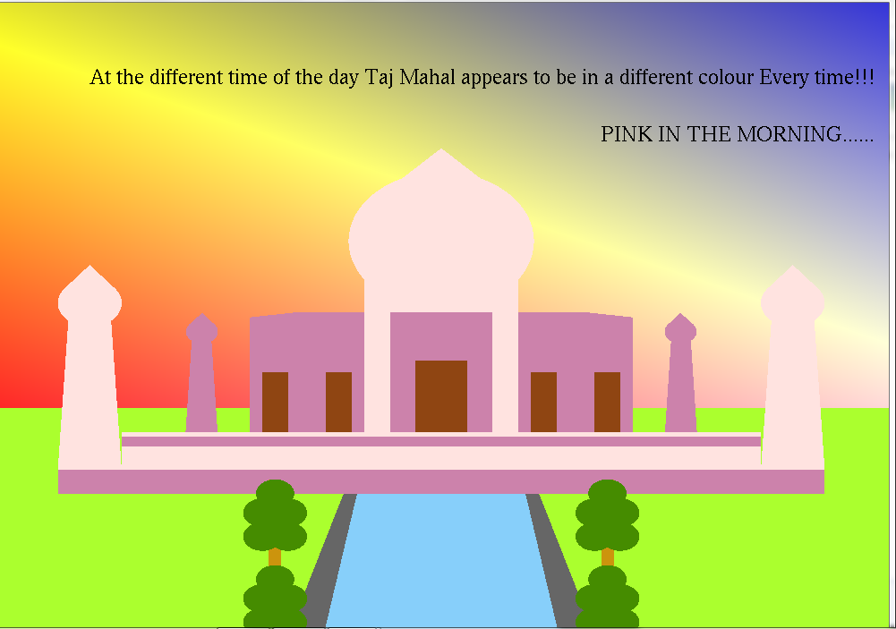
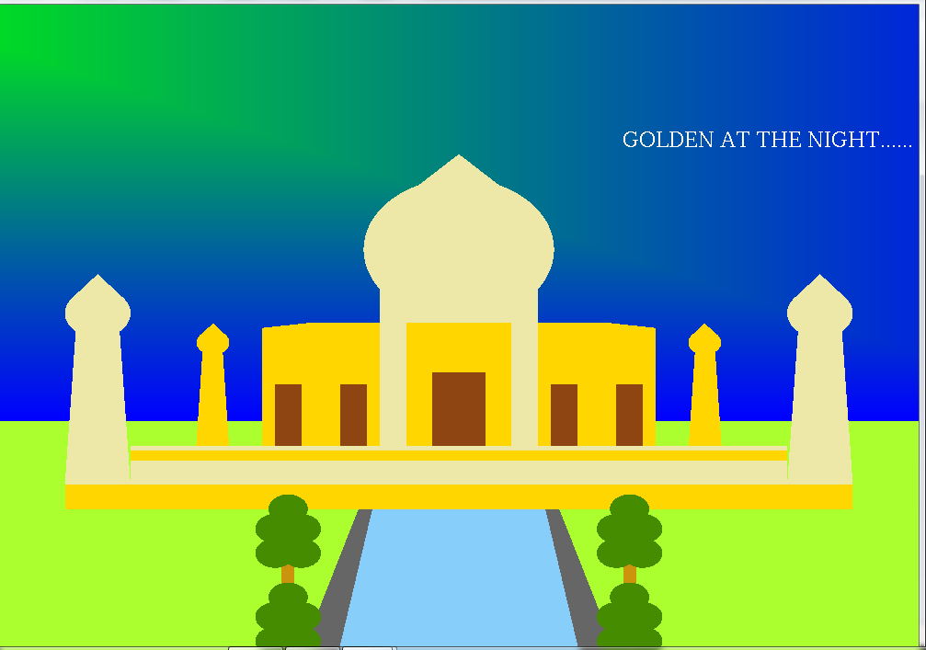
Screenshots of our project
Fun facts about Tajmahal
Tajmahal at the day
Pink in the morning
Golden at the night

Slide 5

Thank You

